Slide 1
Virtualization Technique

Slide 2
Contents
Virtualization Technique
CPU Virtualization
Emulation techniques
Trap and emulate model
Hardware assistance
Memory Virtualization
Shadow page table
Hardware assistance
IO Virtualization
Overview
Device model
Hardware assistance
Ecosystem
VMware
Xen
KVM
Other Issues
Live migration
Cloud properties

Slide 3
CPU Virtualization
Emulation techniques
Trap and emulate paradigm
Hardware assistance

Slide 4
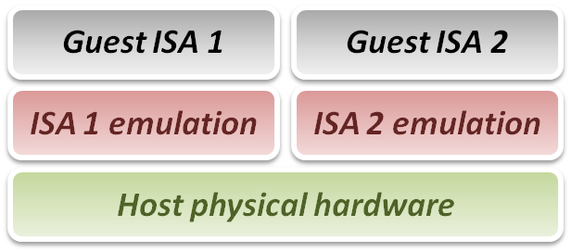
Emulation Technique
Why do we talk about emulation ?
In fact, virtualization technique can be treated as a special case of emulation technique.
Many virtualization techniques were developed in or inherited from emulation technique.
Goal of emulation :
Provide a method for enabling a (sub)system to present the same interface and characteristics as another.

Slide 5
Emulation Technique
Three emulation implementations :
Interpretation
Emulator interprets only one instruction at a time.
Static Binary Translation
Emulator translates a block of guest binary at a time and further optimizes for repeated instruction executions.
Dynamic Binary Translation
This is a hybrid approach of emulator, which mix two approaches above.
Design challenges and issues :
Register mapping problem
Performance improvement

Slide 6
Interpretation
Interpreter execution flow :
Fetch one guest instruction from guest memory image.
Decode and dispatch to corresponding emulation unit.
Execute the functionality of that instruction and modify some related system states, such as simulated register values.
Increase the guest PC (Program Counter register) and then repeat this process again.
Pros & Cons
Pros
Easy to implement
Cons
Poor performance

Slide 7
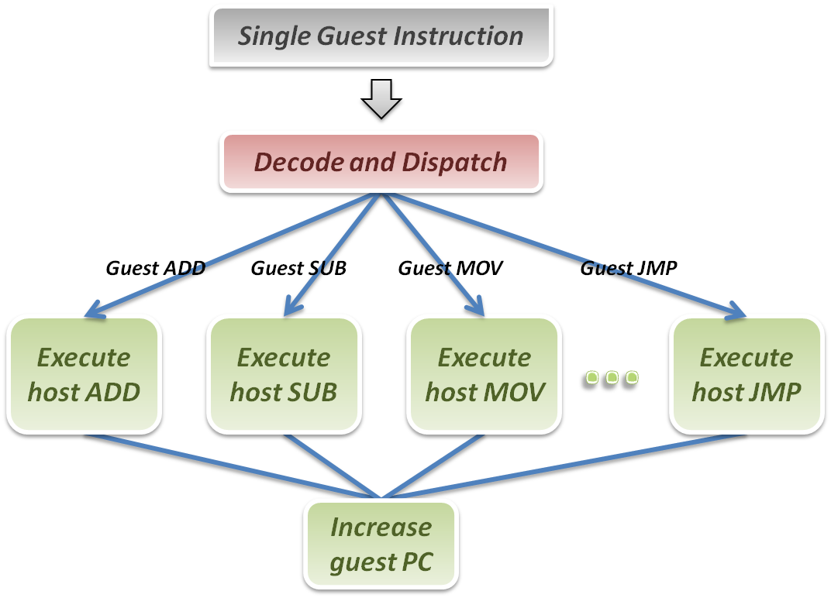
Interpretation
Interpreter

Slide 8
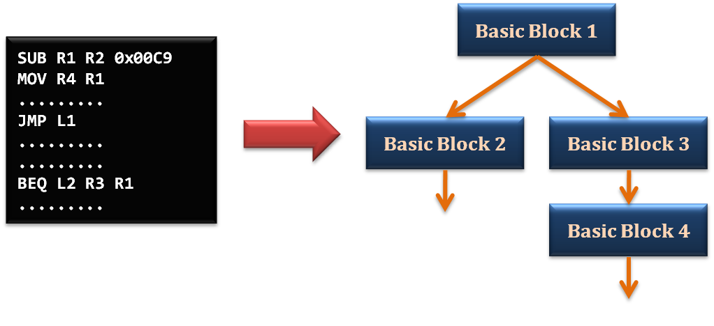
Static Binary Translation
Using the concept of basic block which comes from compiler optimization technique.
A basic block is a portion of the code within a program with certain desirable properties that make it highly amenable to analysis.
A basic block has only one entry point, meaning no code within it is the destination of a jump instruction anywhere in the program.
A basic block has only one exit point, meaning only the last instruction can cause the program to begin executing code in a different basic block.

Slide 9
Static Binary Translation
Static binary translation flow :
Fetch one block of guest instructions from guest memory image.
Decode and dispatch each instruction to the corresponding translation unit.
Translate guest instruction to host instructions.
Write the translated host instructions to code cache.
Execute the translated host instruction block in code cache.
Pros & Cons
Pros
Emulator can reuse the translated host code.
Emulator can apply more optimization when translating guest blocks.
Cons
Implementation complexity will increase.

Slide 10
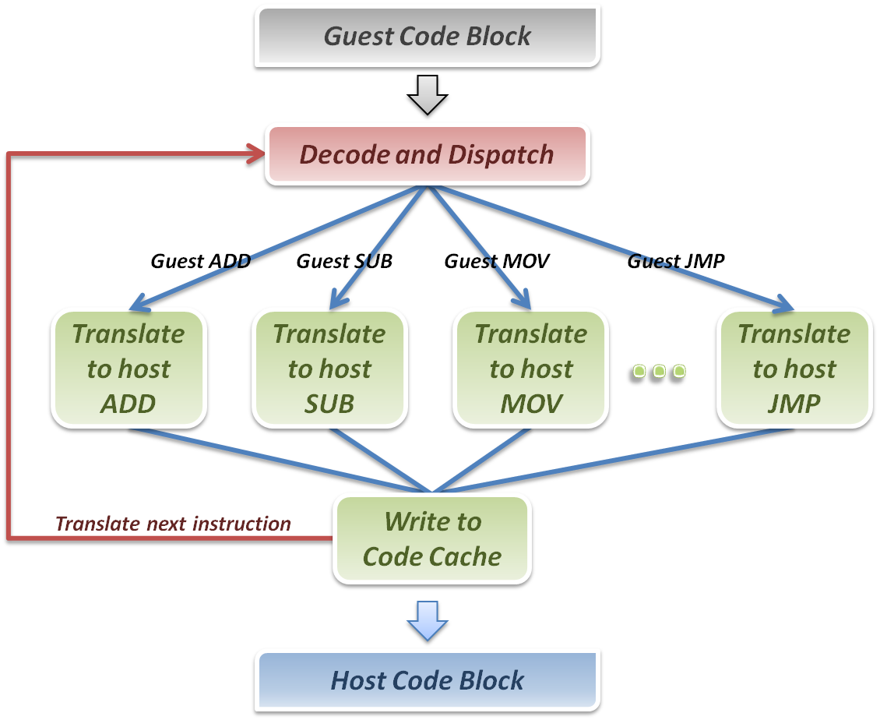
Binary Translation
Binary Translator

Slide 11
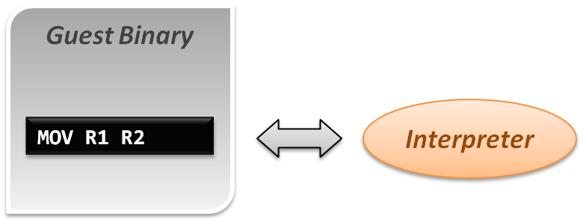
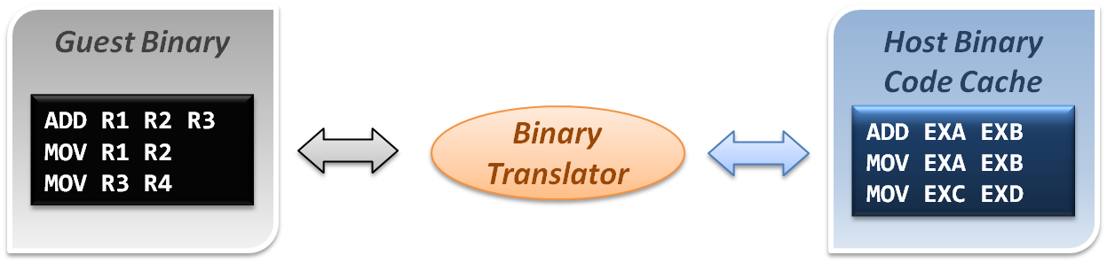
Comparison
Interpretation implementation
Static binary translation implementation

Slide 12
Dynamic Binary Translation
A hybrid implementation
For the first discovered codes, directly interpret by interpreter and record these codes as discovered.
As the guest codes discovered, trigger the binary translation module to translate the guest code blocks to host code blocks, and place them into code cache.
When execute the translated block of guest code next time, jump to the code cache and execute the translated host binary code.
Pros & Cons
Pros
Transparently implement binary translation.
Cons
Hard to implement.

Slide 13
Dynamic Binary Translation
First time execution, no translated code in code cache.
Miss code cache matching, then directly interpret the guest instruction.
As a code block discovered, trigger the binary translation module.
Translate guest code block to host binary, and place it in the code cache.
Next time execution, run the translated code clock in the code cache.
Binary Translator
Guest Binary
trigger
Host Binary Code Cache
Emulation Manager
hit
exit
return
miss
Interpreter

Slide 14
Design challenges and issues
Register mapping problem
Performance improvement

Slide 15
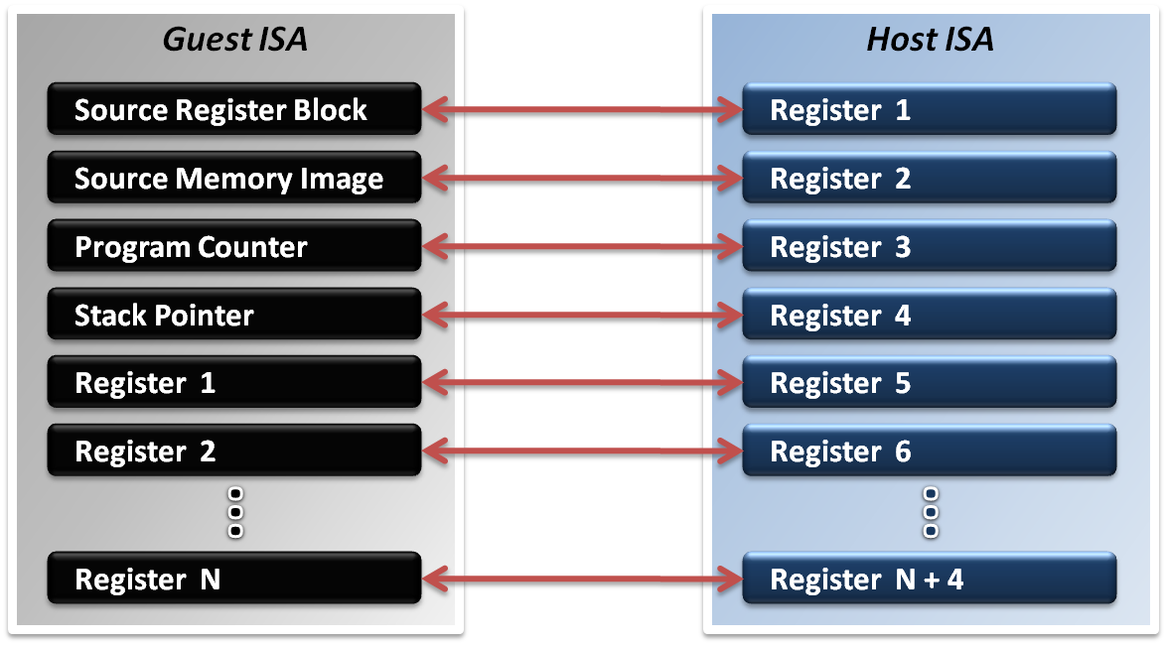
Register Mapping Problem
Why should we map registers ?
Different ISA will define different number of registers.
Sometimes guest ISA even require some special purpose register which host ISA does not defined.

Slide 16
Register Mapping Problem
Mapping different purpose of registers :
Map special purpose registers
Program Counter Register
Stack Pointer Register
Page Table Register
System Statues Register
Special Flags Register
Hold guest context and memory image
Map general purpose registers
Map intermediate values

Slide 17
Register Mapping Problem
If number of host registers is larger the guest
That will be an easier case for implementation.
Directly map one register of guest to one of host, and make use of the rest registers for optimization.
Example :
Translating x86 binary to RISC
If number of host registers is not enough
That should involve more effort.
Emulator may only map some frequently used guest registers to host, and left the unmapped registers in memory.
Mapping decision will be critical in this case.

Slide 18
Performance Improvement
What introduces the performance hit ?
Control flow problem
Highly frequent context switches between code caches and emulation manager will degrade performance.
Target code optimization
Translate guest code block in instruction-wise (translate one instruction at a time) will miss many optimization opportunities.
Solutions :
Translation Chaining
Dynamic Optimization

Slide 19
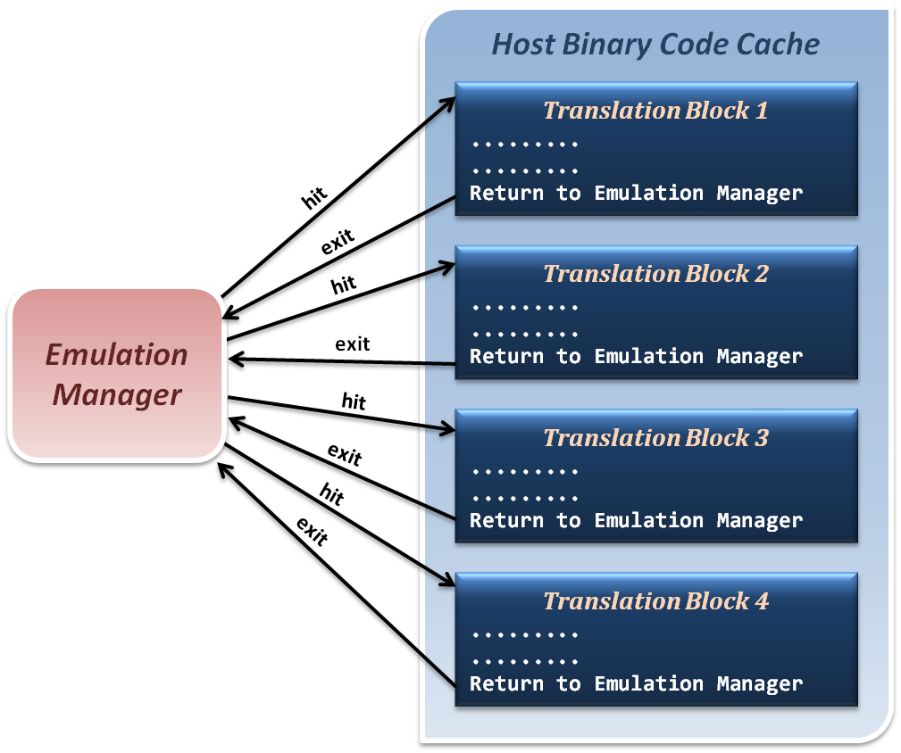
Translation Chaining
Non-optimized control flow between translated blocks and emulation manager.
Context Switches

Slide 20
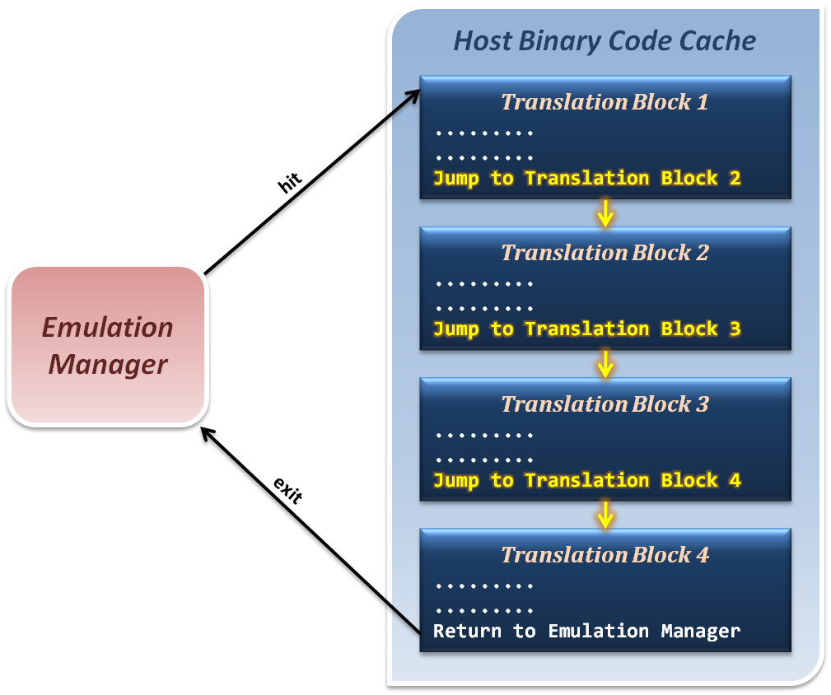
Translation Chaining
Jump from one translation directly to next, which avoid switching back to emulation manager.

Slide 21
Dynamic Optimization
How to optimize binary codes ?
Static optimization (compiling time optimization)
Optimization techniques apply to generate binary code base on the semantic information in source code.
Dynamic optimization (run time optimization)
Optimization techniques apply to generated binary code base on the run time information which relate to program input data.
Why we use dynamic optimization technique ?
Advantages :
It can benefit from dynamic profiling.
It is not constrained by a compilation unit.
It knows the exact execution environment.

Slide 22
Dynamic Optimization
How to implement dynamic optimization ?
Analysis program behavior in run time.
Collect run time profiling information based on the input data and host hardware characteristics.
Dynamically translate or modify the binary code by reordering instructions or other techniques.
Write back the optimized binary into code cache for next execution.

Slide 23
Dynamic Optimization
How to analyze program behavior and profile ?
Collect statistics about a program as it runs
Branches (taken, not taken)
Jump targets
Data values
Cache misses
Predictability allows these statistics to be used for optimizations to be used in the future
Profiling in a VM differs from traditional profiling used for compiler feedback.

Slide 24
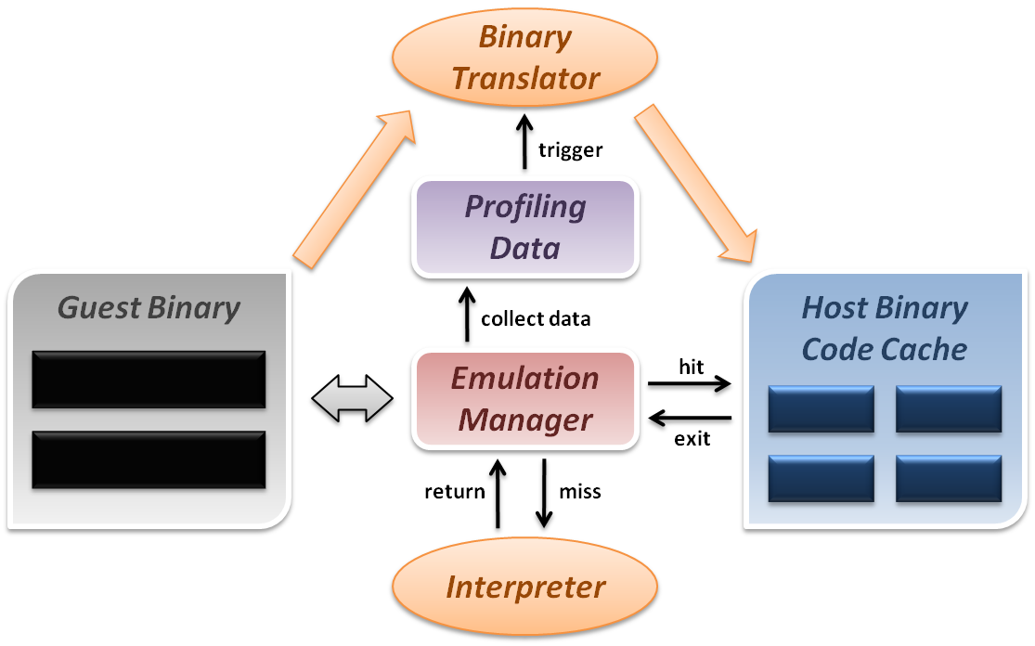
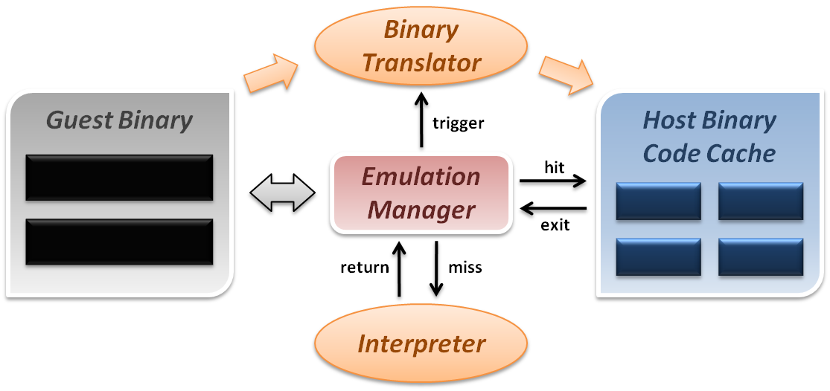
Dynamic Optimization
Dynamic binary translation and optimization :

Slide 25
CPU Virtualization
Emulation techniques
Trap and emulate model
Hardware assistance

Slide 26
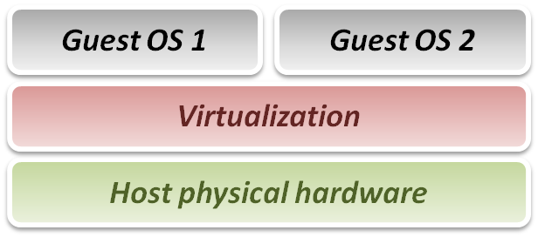
Virtualization Technique
From emulation to virtualization :
While emulation techniques emulate guest on host, whose ISA differ from guest, in virtualization techniques, guest and host have the same ISA.
Some problems in emulation will not exist in virtualization :
No need to translate each binary instruction to host ISA.
No need to worry about unmatched special register mapping.
Some new problems didn’t exist in emulation exist now :
Instruction privileges should be well-controlled.
Goal of virtualization :
Run or simulate all instructions of guest OS.

Slide 27
Virtualization Technique
Virtualization requirements from Popek and Goldberg :
Popek and Goldberg provide a set of sufficient conditions for a computer architecture to efficiently support system virtualization.
Popek and Goldberg provide guidelines for the design of virtualized computer architectures.
In Popek and Goldberg terminology, a VMM must present all three properties :
Equivalence (Same as real machine)
Resource control (Totally control)
Efficiency (Native execution)

Slide 28
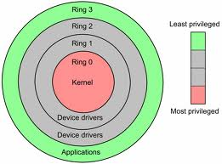
CPU Architecture
Modern CPU status is usually classified as several modes.
In general, we conceptually divide them into two modes :
Kernel mode (Ring 0)
CPU may perform any operation allowed by its architecture, including any instruction execution, IO operation, area of memory access, and so on.
Traditional OS kernel runs in Ring 1 mode.
User mode (Ring 1 ~ 3)
CPU can typically only execute a subset of those available instructions in kernel mode.
Traditional application runs in Ring 3 mode.

Slide 29
CPU Architecture
By the classification of CPU modes, we divide instructions into following types :
Privileged instruction
Those instructions that trap if the machine is in user mode and do not trap if the machine is in kernel mode.
Sensitive instructions
Those instructions that interact with hardware, which include control-sensitive and behavior-sensitive instructions.
Innocuous instruction
All other instructions.
Critical instruction
Those sensitive but not privileged instructions.

Slide 30
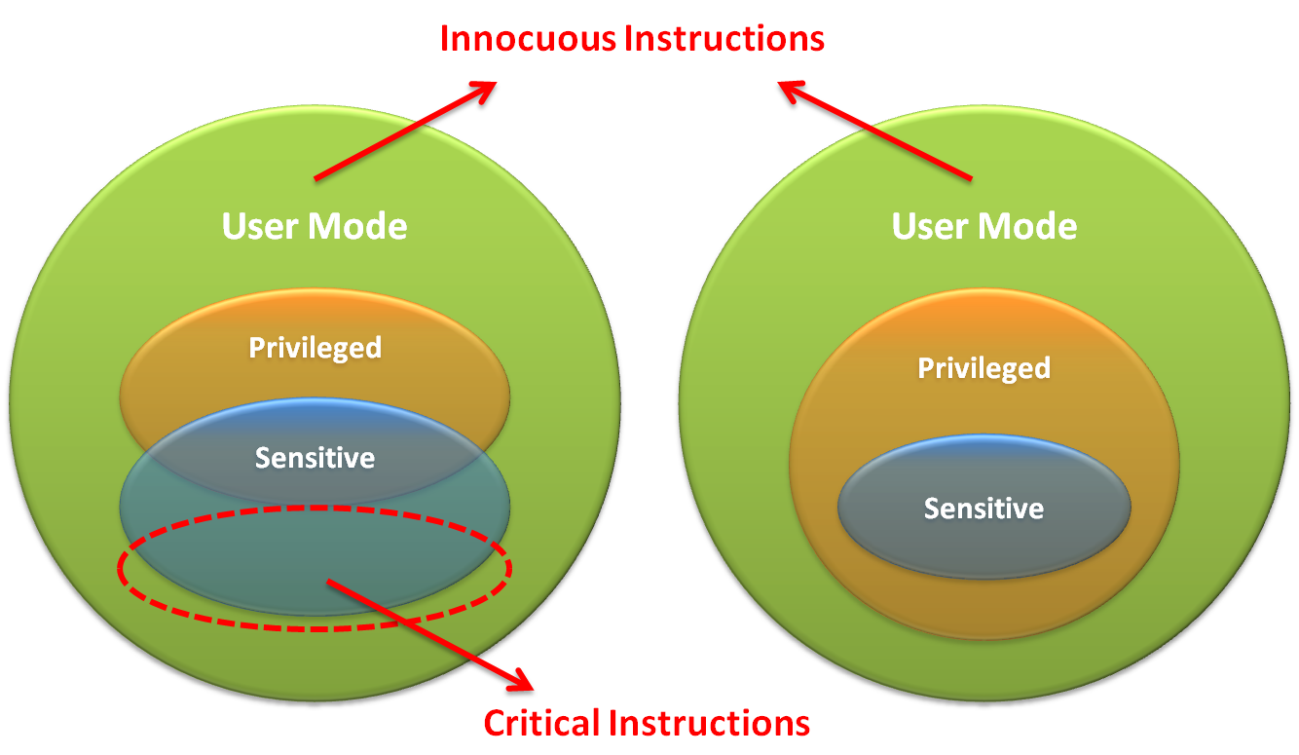
CPU Architecture

Slide 31
CPU Architecture
What is trap ?
When CPU is running in user mode, some internal or external events, which need to be handled in kernel mode, take place.
Then CPU will jump to hardware exception handler vector, and execute system operations in kernel mode.
Trap types :
System Call
Invoked by application in user mode.
For example, application ask OS for system IO.
Hardware Interrupts
Invoked by some hardware events in any mode.
For example, hardware clock timer trigger event.
Exception
Invoked when unexpected error or system malfunction occur.
For example, execute privilege instructions in user mode.

Slide 32
Trap and Emulate Model
If we want CPU virtualization to be efficient, how should we implement the VMM ?
We should make guest binaries run on CPU as fast as possible.
Theoretically speaking, if we can run all guest binaries natively, there will NO overhead at all.
But we cannot let guest OS handle everything, VMM should be able to control all hardware resources.
Solution :
Ring Compression
Shift traditional OS from kernel mode(Ring 0) to user mode(Ring 1), and run VMM in kernel mode.
Then VMM will be able to intercept all trapping event.

Slide 33
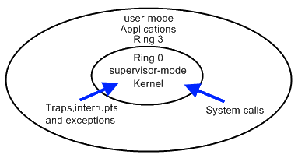
Trap and Emulate Model
VMM virtualization paradigm (trap and emulate) :
Let normal instructions of guest OS run directly on processor in user mode.
When executing privileged instructions, hardware will make processor trap into the VMM.
The VMM emulates the effect of the privileged instructions for the guest OS and return to guest.

Slide 34
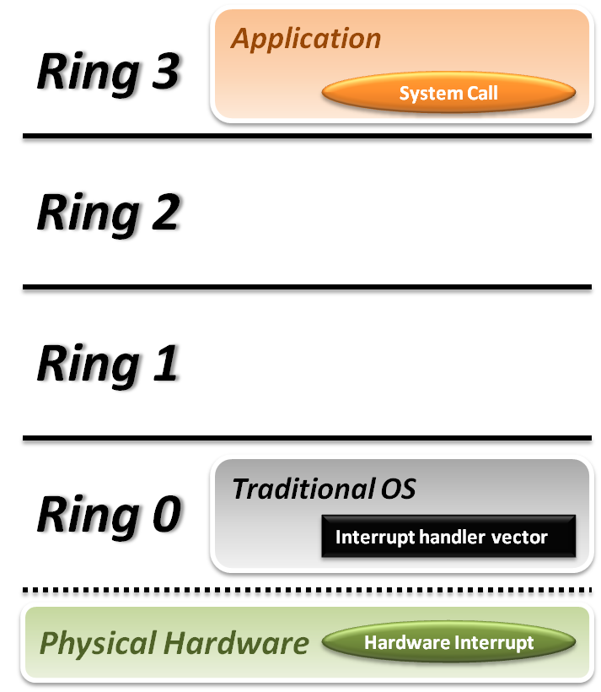


Trap and Emulate Model
Traditional OS :
When application invoke a system call :
CPU will trap to interrupt handler vector in OS.
CPU will switch to kernel mode (Ring 0) and execute OS instructions.
When hardware event :
Hardware will interrupt CPU execution, and jump to interrupt handler in OS.

Slide 35
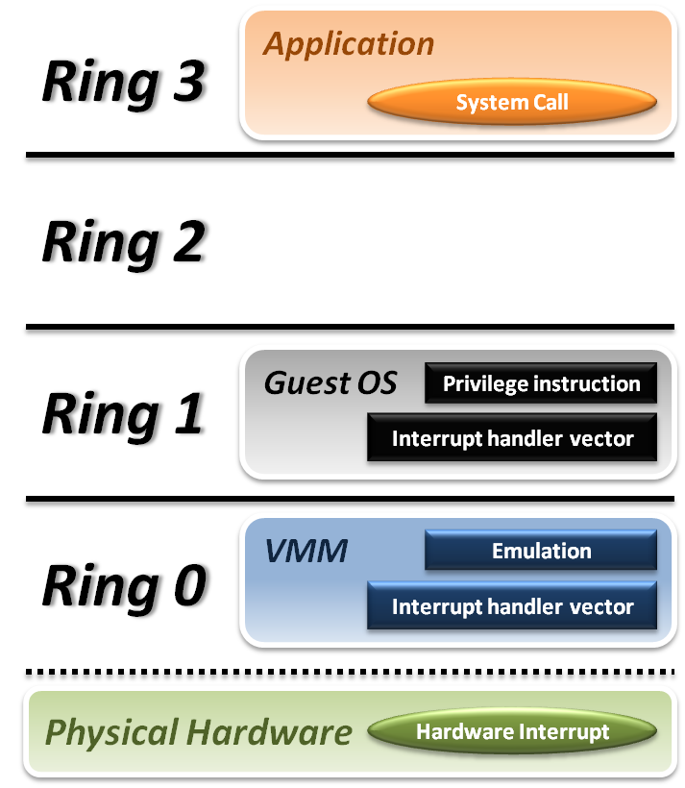






Trap and Emulate Model
VMM and Guest OS :
System Call
CPU will trap to interrupt handler vector of VMM.
VMM jump back into guest OS.
Hardware Interrupt
Hardware make CPU trap to interrupt handler of VMM.
VMM jump to corresponding interrupt handler of guest OS.
Privilege Instruction
Running privilege instructions in guest OS will be trapped to VMM for instruction emulation.
After emulation, VMM jump back to guest OS.

Slide 36
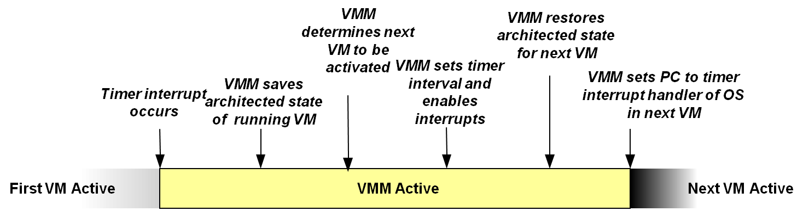
Context Switch
Steps of VMM switch different virtual machines :
Timer Interrupt in running VM.
Context switch to VMM.
VMM saves state of running VM.
VMM determines next VM to execute.
VMM sets timer interrupt.
VMM restores state of next VM.
VMM sets PC to timer interrupt handler of next VM.
Next VM active.

Slide 37
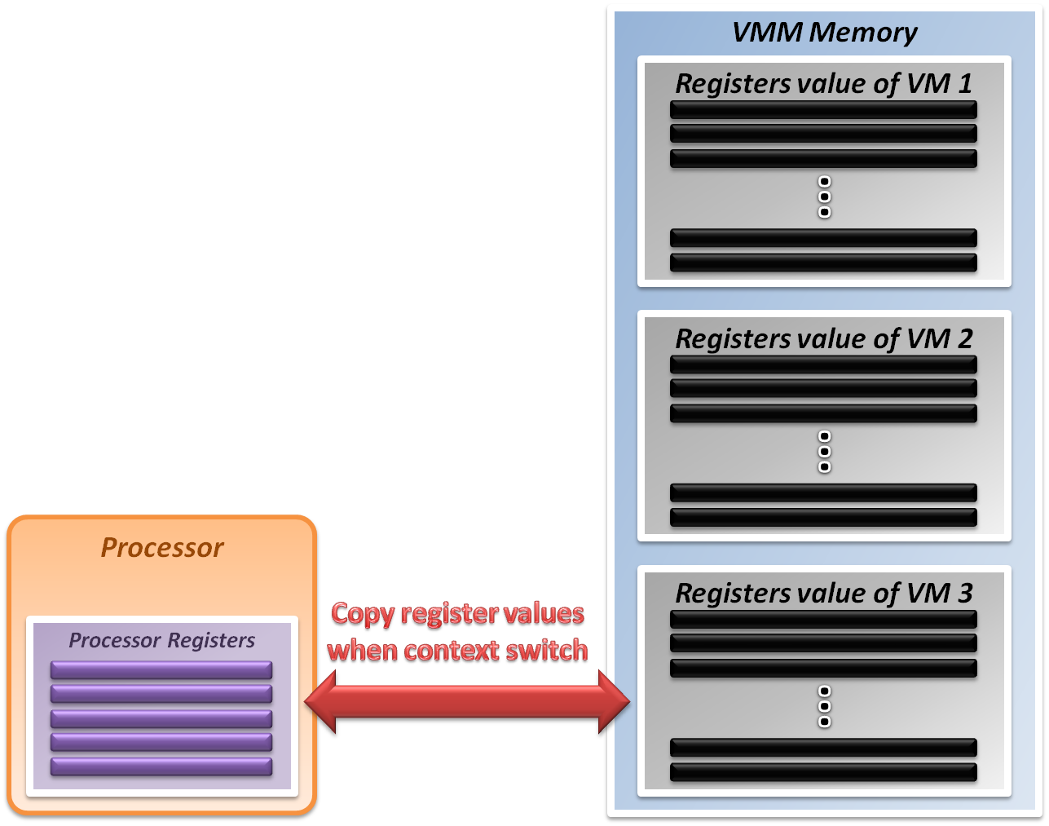
System State Management
Virtualizing system state :
VMM will hold the system states of all virtual machines in memory.
When VMM context switch from one virtual machine to another
Write the register values back to memory
Copy the register values of next guest OS to CPU registers.

Slide 38
Virtualization Theorem
Subset theorem :
For any conventional third-generation computer, a VMM may be constructed if the set of sensitive instructions for that computer is a subset of the set of privileged instructions.
Recursive Emulation :
A conventional third-generation computer is recursively virtualizable if
It is virtualizable
VMM without any timing dependencies can be constructed for it.
Under this theorem, x86 architecture cannot be virtualized directly. Other techniques are needed.

Slide 39
Virtualization Techniques
How to virtualize unvirtualizable hardware :
Para-virtualization
Modify guest OS to skip the critical instructions.
Implement some hyper-calls to trap guest OS to VMM.
Binary translation
Use emulation technique to make hardware virtualizable.
Skip the critical instructions by means of these translations.
Hardware assistance
Modify or enhance ISA of hardware to provide virtualizable architecture.
Reduce the complexity of VMM implementation.

Slide 40
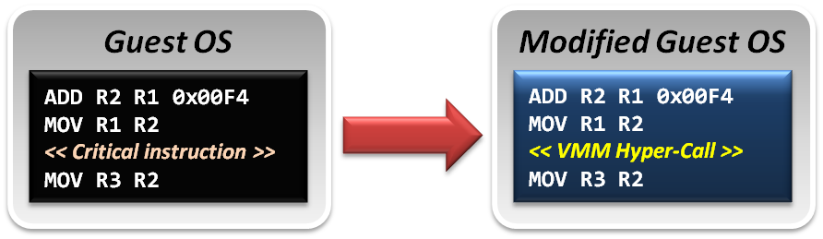
Para-Virtualization
Para-Virtualization implementation :
In para-virtualization technique, guest OS should be modified to prevent invoking critical instructions.
Instead of knowing nothing about hypervisor, guest OS will be aware of the existence of VMM, and collaborate with VMM smoothly.
VMM will provide the hyper-call interfaces, which will be the communication channel between guest and host.

Slide 41
Binary Translation
In emulation techniques :
Binary translation module is used to optimize binary code blocks, and translate binaries from guest ISA to host ISA.
In virtualization techniques :
Binary translation module is used to skip or modify the guest OS binary code blocks which include critical instructions.
Translate those critical instructions into some privilege instructions which will trap to VMM for further emulation.

Slide 42
Binary Translation
Static approach vs. Dynamic approach :
Static binary translation
The entire executable file is translated into an executable of the target architecture.
This is very difficult to do correctly, since not all the code can be discovered by the translator.
Dynamic binary translation
Looks at a short sequence of code, typically on the order of a single basic block, translates it and caches the resulting sequence.
Code is only translated as it is discovered and when possible, branch instructions are made to point to already translated and saved code.

Slide 43
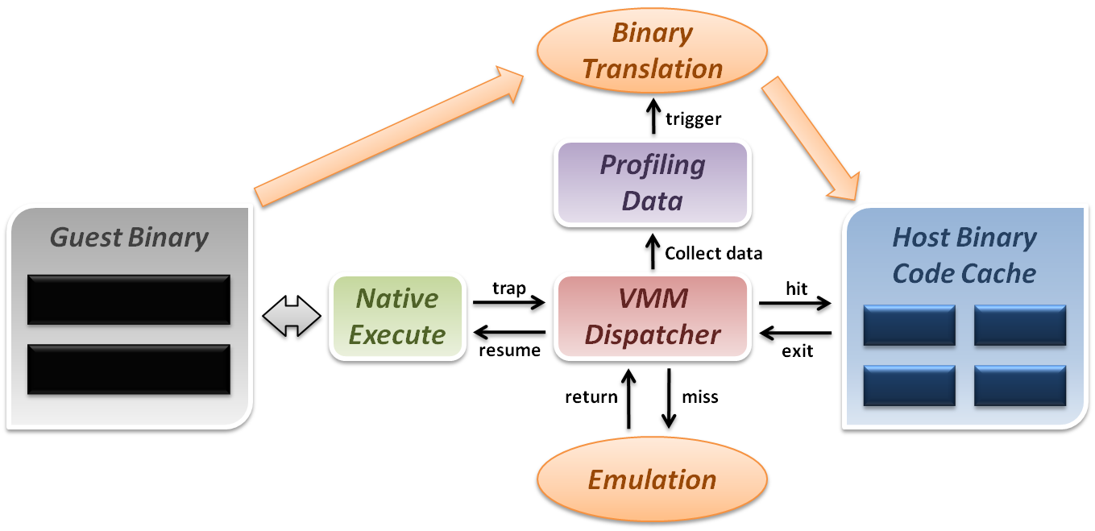
Binary Translation
Dynamic binary translation and optimization
VMM can dynamically translate binary code and collect profiling data for further optimization.

Slide 44
Some Difficulties
Difficulties of binary translation :
Self-modifying code
If guest OS will modify its own binary code in runtime, binary translation need to flush the responding code cache and retranslate the code block.
Self-reference code
If guest code need to reference(read) its own binary code in runtime, VMM need to make it referring back to original guest binaries location.
Real-time system
For some timing critical guest OS, emulation environment will lose precise timing, and this problem cannot be perfectly solved yet.
Difficulty of para-virtualization :
Guest OS modification
User should at least has the source code of guest OS and modify its kernel; otherwise, para-virtualization cannot be used.

Slide 45
CPU Virtualization
Emulation techniques
Trap and emulate model
Hardware assistance

Slide 46
Hardware Solution
Why are there so many problems and difficulties ?
Critical instructions do not trap in user mode.
Even if we make those critical instructions trap, their semantic may also be changed; which is not acceptable.
In short, legacy processors did not design for virtualization purpose at the beginning.
If processor can be aware of the different behaviors between guest and host, the VMM design will be more efficient and simple.

Slide 47
Hardware Solution
Let’s go back to trap model :
Some trap types do not need the VMM involvement.
For example, all system calls invoked by application in guest OS should be caught by gust OS only. There is no need to trap to VMM and then forward it back to guest OS, which will introduce context switch overhead.
Some critical instructions should not be executed by guest OS.
Although we make those critical instructions trap to VMM, VMM cannot identify whether this trapping action is caused by the emulation purpose or the real OS execution exception.
Solution :
We need to redefine the semantic of some instructions.
We need to introduce new CPU control paradigm.

Slide 48
Intel VT-x
In order to straighten those problems out, Intel introduces one more operation mode of x86 architecture.
VMX Root Operation (Root Mode)
All instruction behaviors in this mode are no different to traditional ones.
All legacy software can run in this mode correctly.
VMM should run in this mode and control all system resources.
VMX Non-Root Operation (Non-Root Mode)
All sensitive instruction behaviors in this mode are redefined.
The sensitive instructions will trap to Root Mode.
Guest OS should run in this mode and be fully virtualized through typical “trap and emulation model”.

Slide 49
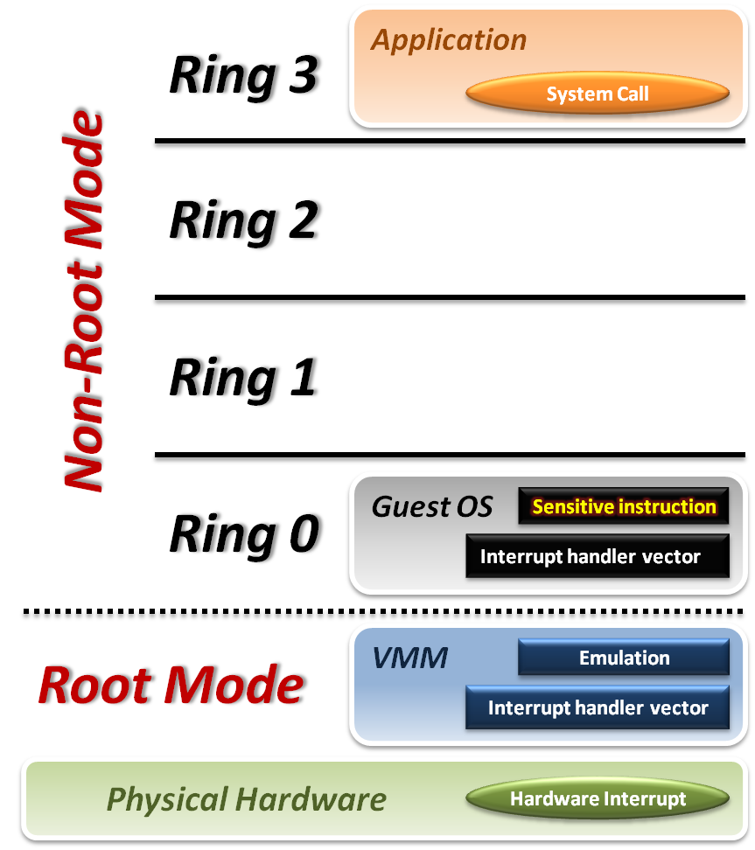





Intel VT-x
VMM with VT-x :
System Call
CPU will directly trap to interrupt handler vector of guest OS.
Hardware Interrupt
Still, hardware events need to be handled by VMM first.
Sensitive Instruction
Instead of trap all privilege instructions, running guest OS in Non-root mode will trap sensitive instruction only.

Slide 50
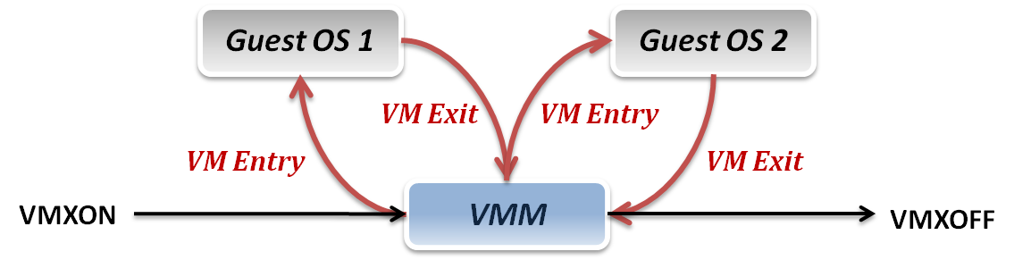
Context Switch
VMM switch different virtual machines with Intel VT-x :
VMXON/VMXOFF
These two instructions are used to turn on/off CPU Root Mode.
VM Entry
This is usually caused by the execution of VMLAUNCH/VMRESUME instructions, which will switch CPU mode from Root Mode to Non-Root Mode.
VM Exit
This may be caused by many reasons, such as hardware interrupts or sensitive instruction executions.
Switch CPU mode from Non-Root Mode to Root Mode.

Slide 51
System State Management
Intel introduces a more efficient hardware approach for register switching, VMCS (Virtual Machine Control Structure) :
State Area
Store host OS system state when VM-Entry.
Store guest OS system state when VM-Exit.
Control Area
Control instruction behaviors in Non-Root Mode.
Control VM-Entry and VM-Exit process.
Exit Information
Provide the VM-Exit reason and some hardware information.
Whenever VM Entry or VM Exit occur, CPU will automatically read or write corresponding information into VMCS.

Slide 52
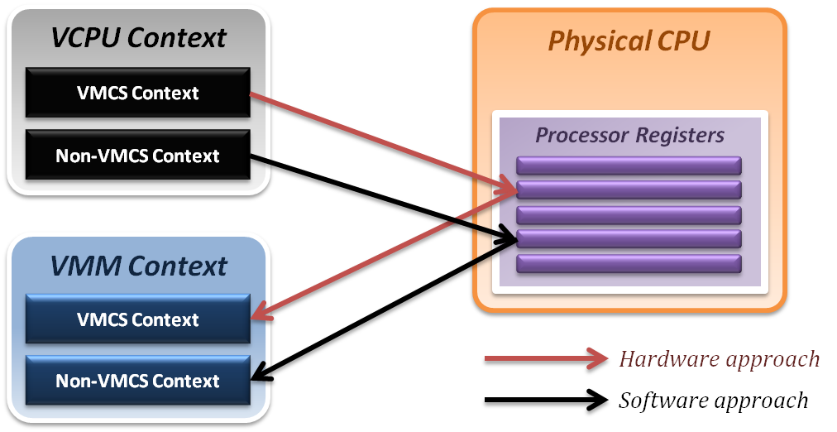
System State Management
Binding virtual machine to virtual CPU
VCPU (Virtual CPU) contains two parts
VMCS maintains virtual system states, which is approached by hardware.
Non-VMCS maintains other non-essential system information, which is approach by software.
VMM needs to handle Non-VMCS part.

Slide 53
CPU Virtualization Summary
Emulation technique
Interpretation and binary translation approaches
System state mapping and performance issue
Translation chaining, Dynamic binary optimization
Virtualization technique
Modern CPU architecture
Trap and emulation model
Critical instruction issue
Para-virtualization, Dynamic binary translation
Hardware assistance
Intel VT-x approach
Root Mode & Non-Root Mode

